Slide 1
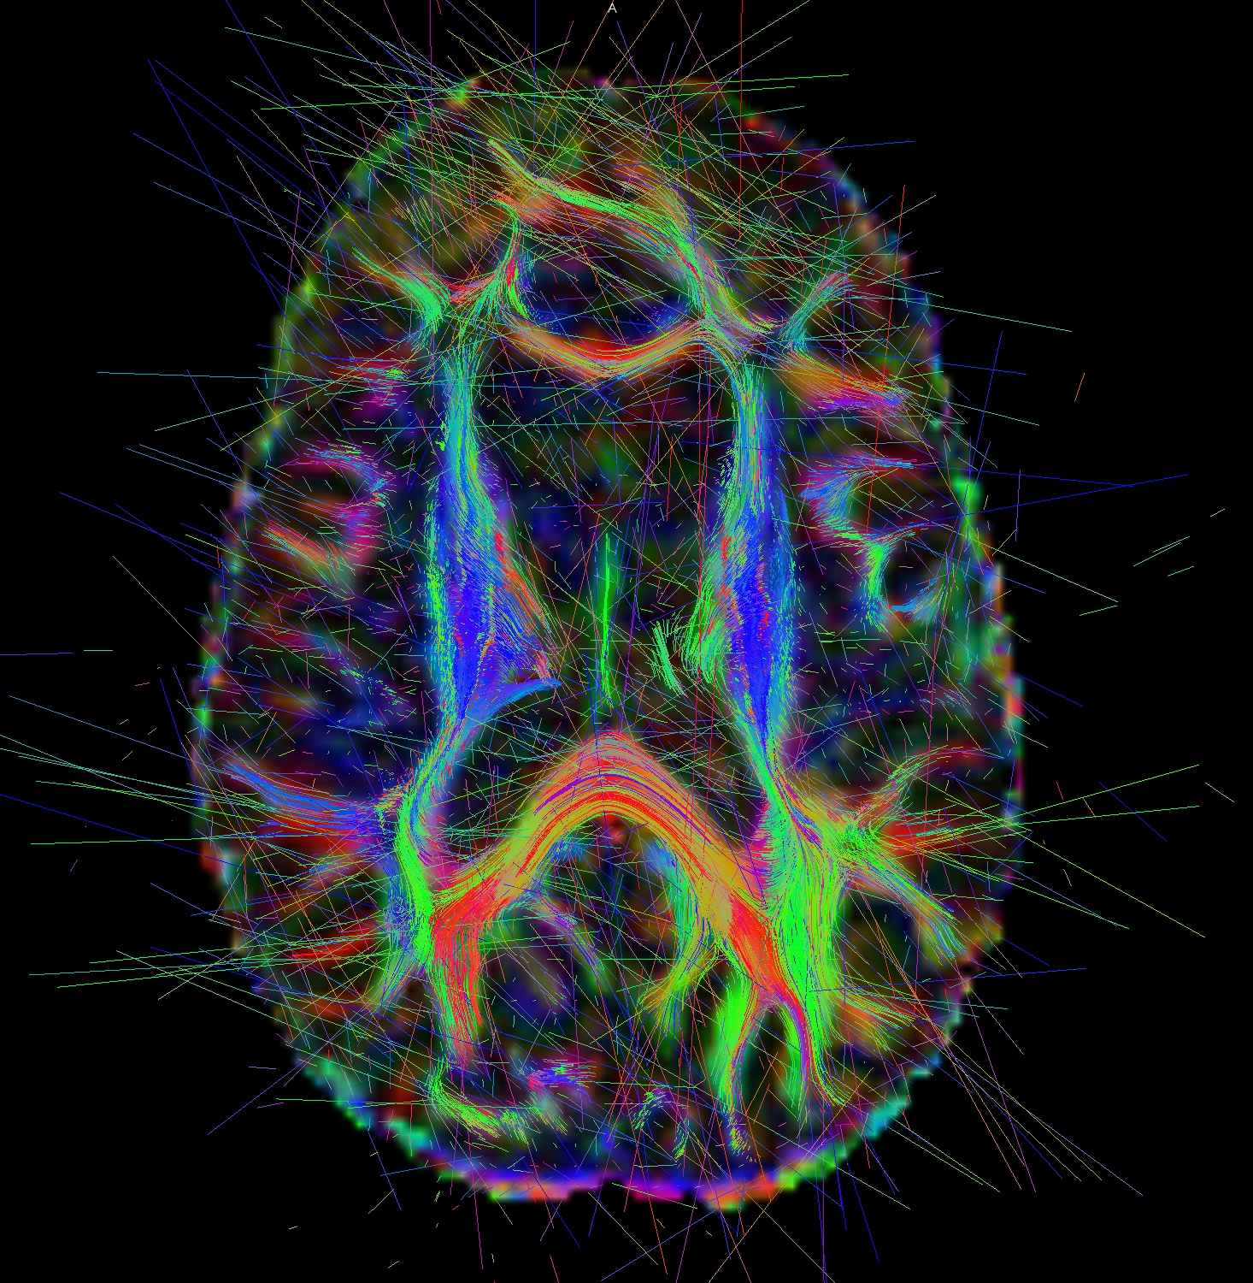
Notes:
Brain Development – We used to think that brain development was all done by age 12.

Slide 2
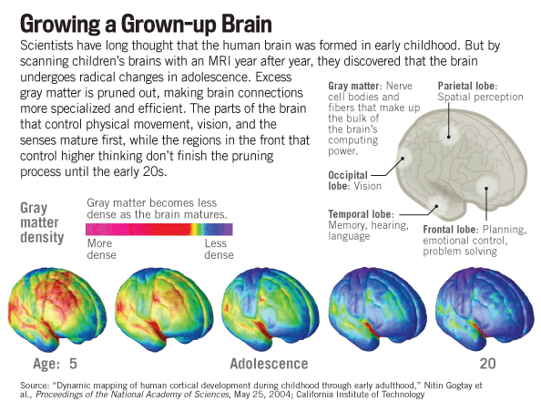

Slide 3
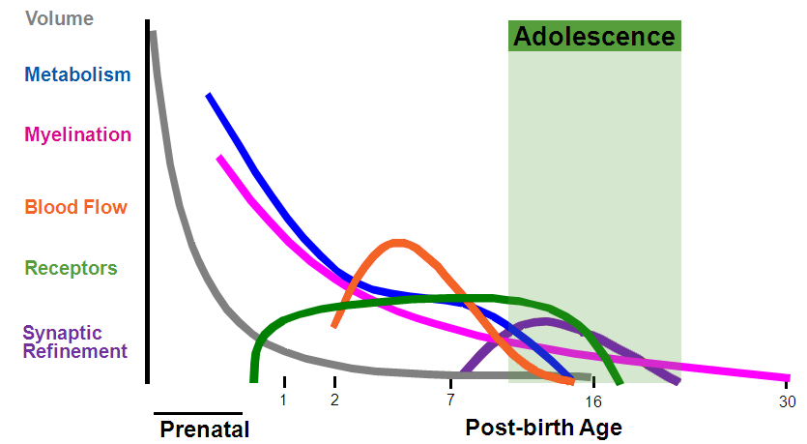
Brain Development
Rate of Change→
Source: Tapert & Schweinsburg, 2005
Notes:
Here is some background about this maturation.
Although most of the brain material and size is in place at the start of adolescence, several important developmental processes continue. Three of them are noteworthy.

Slide 4
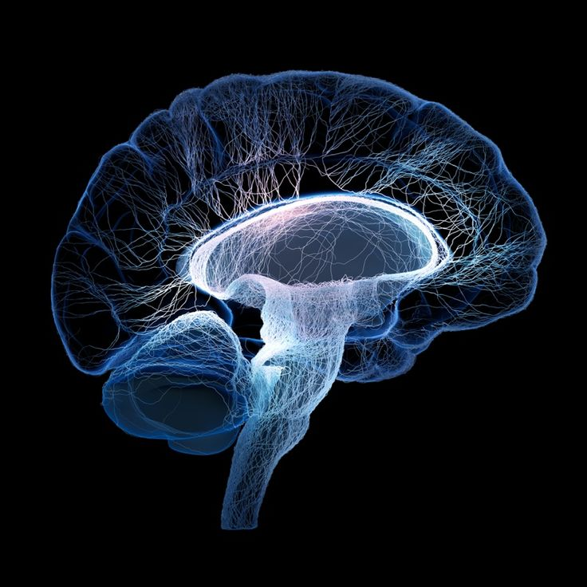
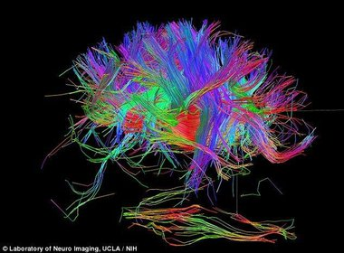
Synaptic Refinement
Notes:
Synaptic Refinement
At the start of adolescence, we have billions of brain cells, each with tens of thousands of connections to other brain cells. Not all these connections are actually needed, and the unnecessary becomeeliminated. This elimination process is shaped by the young person’s activities and experiences, and, as with myelination, it helps the brain work more efficiently.

Slide 5
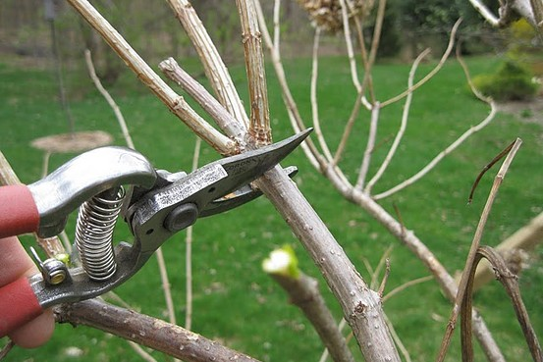
Notes:
Sometimes we think of this as “pruning” the brain

Slide 6
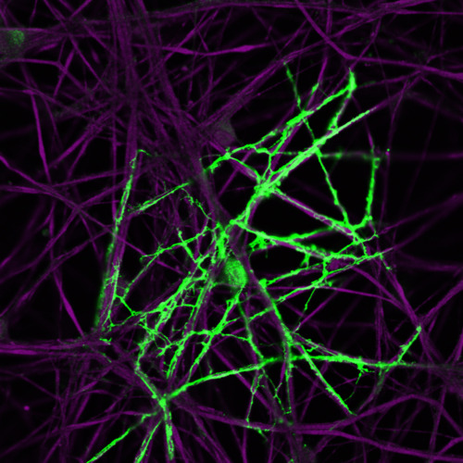
Myelination
Notes:
Mylenation
One process is myelination. The structures or axons connecting brain cells across which electrical impulses travel continue to become ensheathed in a fatty substance called myelin. This compound insulates axons and speeds the relay of electric impulses within the brain, helping thinking, decision-making, impulse control, and emotional regulation mature.

Slide 7
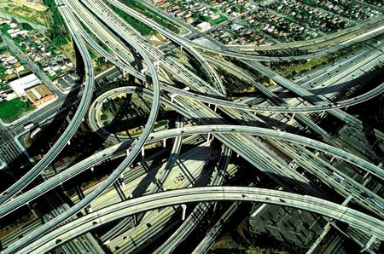
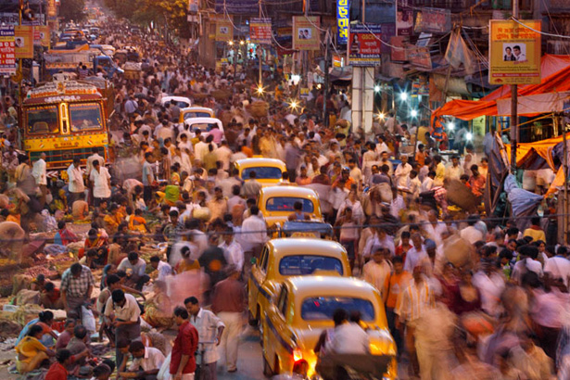

Slide 8
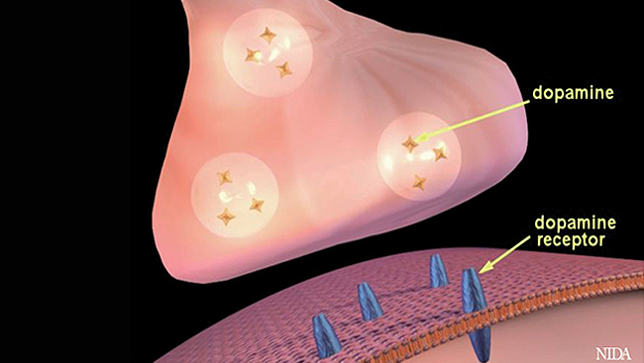
Dopamine Receptors

Slide 9
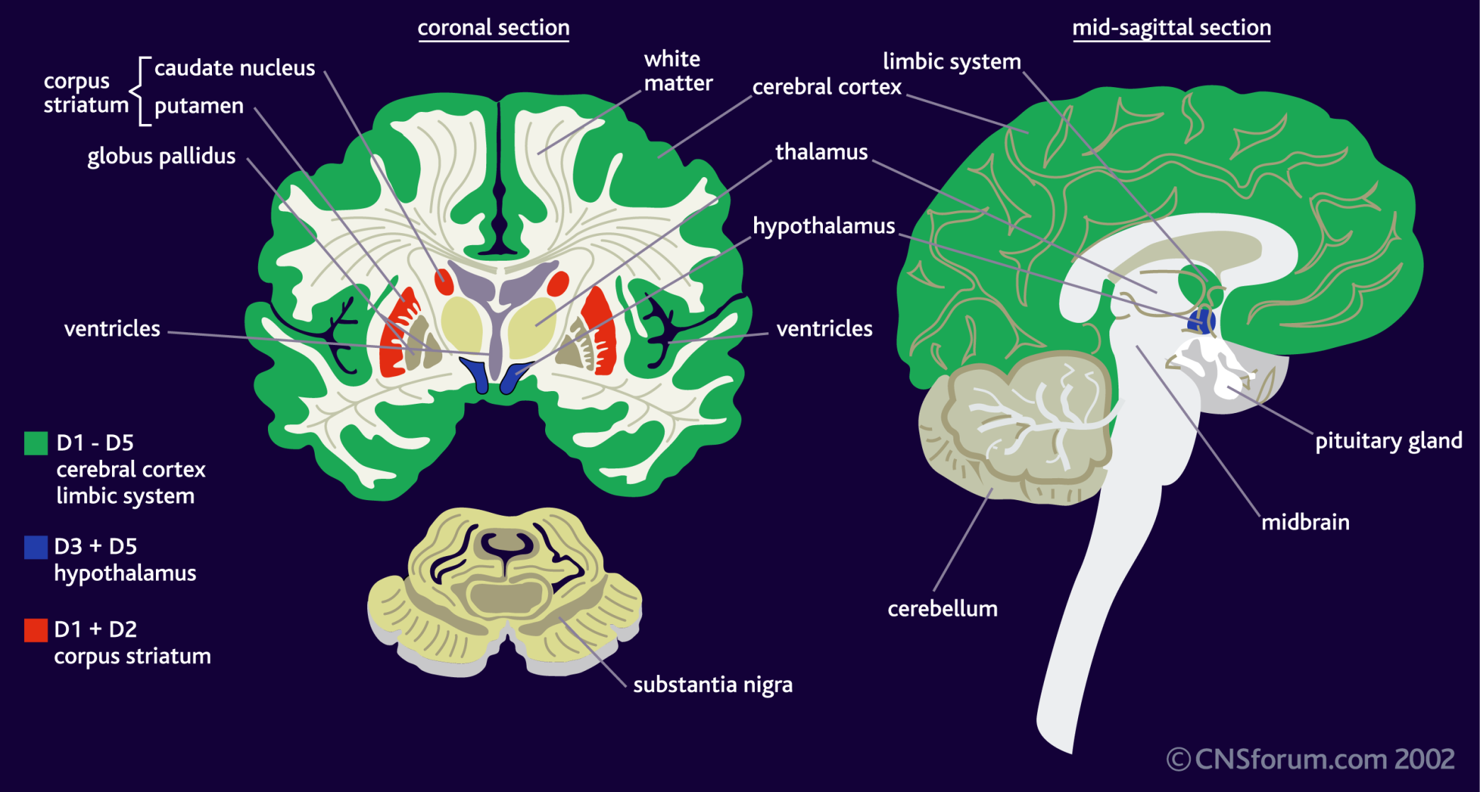
Dopamine Receptors

Slide 10

Act First, Think Later
Preference for Physical Activity and Sensation Seeking
This is Normal Development
More Risky
Impulsive Behavior
Emotions Felt Very Intensely
Less than Optimal Planning
Less Consideration of Negative Consequences
Strongly Influenced by Friends and Peers

Slide 11
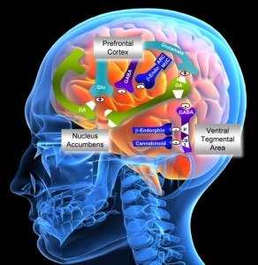

Slide 12
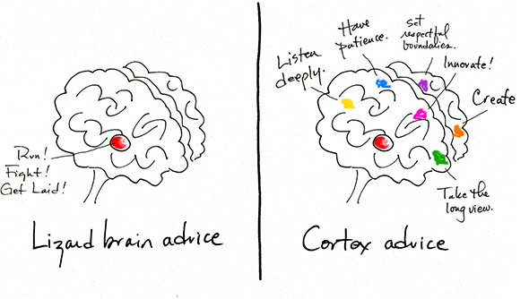
Eat, Drink, Connect

Slide 13
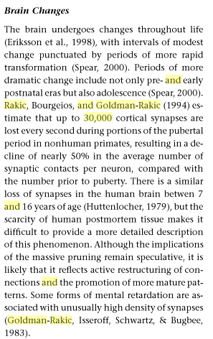

Slide 14
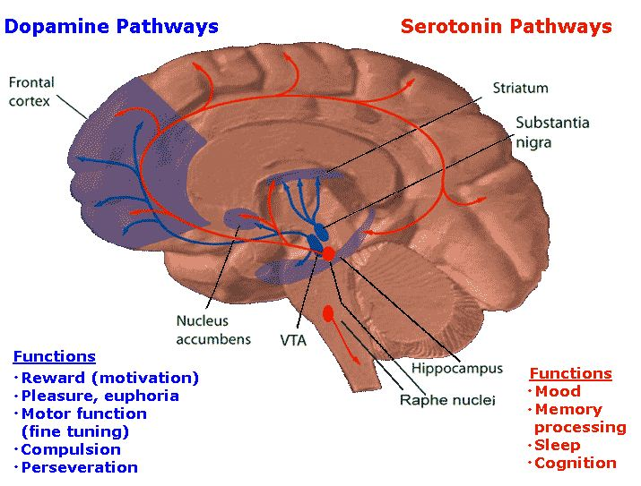
Notes:
Very important here: we have brains that are not fully developed doing two critical things: sheathing pathways of communication in the brain with myelin and performing synaptic refinement: deciding what stays and what goes.
The compulsion and perseveration of the dopamine pathways is critical. Lizard brain: drink, have sex, find food. You want to be obssessed with those thoughts in order to promote your survival
Humans have been on earth 200,000 years, maybe ancient versions of us are found 2 million years ago.

Slide 15

Notes:
Normal day – 50 U of dopamine. Great day – Happy day = 100 U
Sex = 102 U Great food = 90 U. Terrible day – refuse to go to work day, hide under your blankets day = 30
Very few kids feel this way – especially adolescents

Slide 16
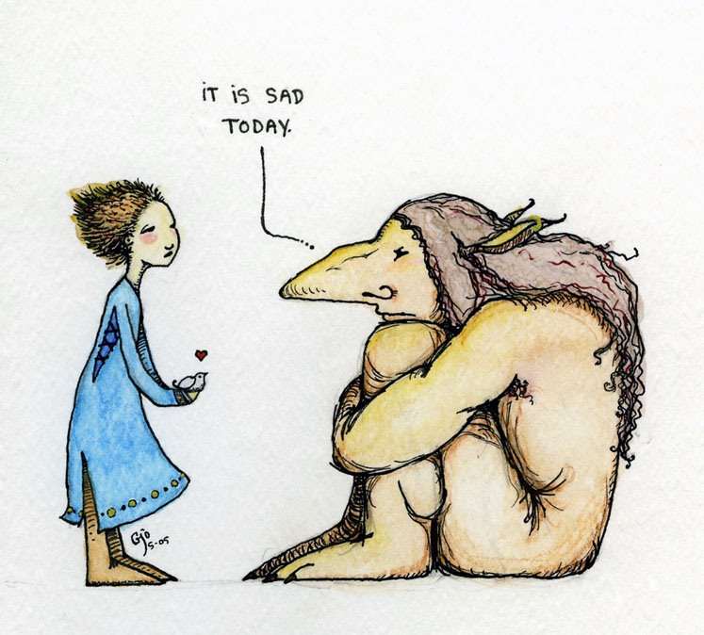
Notes:
Most people with depression, dysthymia are sitting at 30 U of dopamine every day

Slide 17
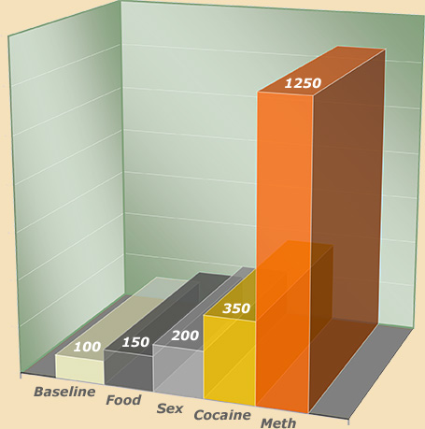

Slide 18
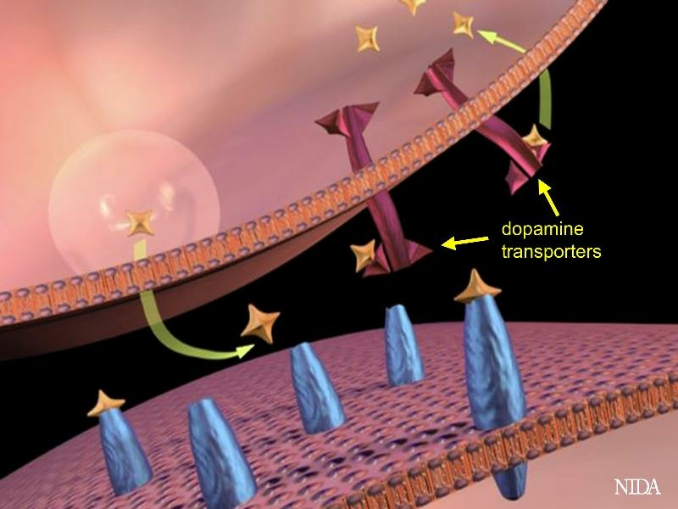

Slide 19
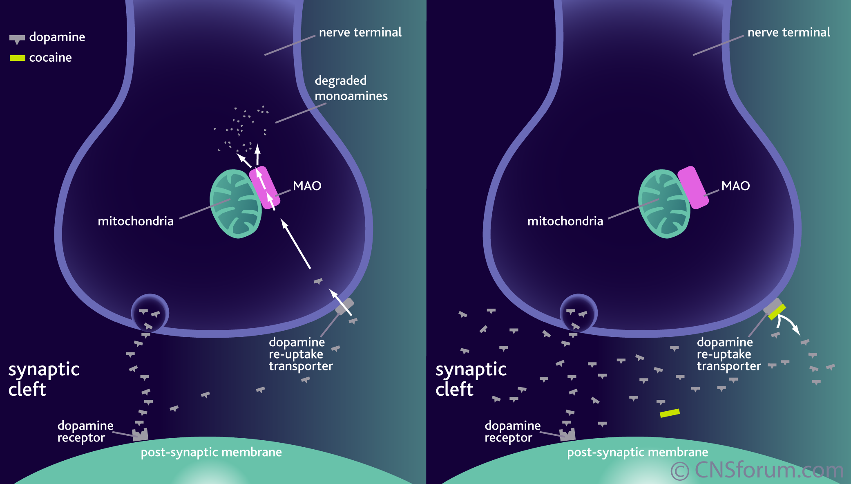
How Cocaine Works
Notes:
Cocaine modifies the action of dopamine in the brain. The dopamine rich areas of the brain are the ventral tegmental area, the nucleus accumbens and the caudate nucleus – these areas are collectively known as the brain’s ‘reward pathway’. Cocaine binds to dopamine re-uptake transporters on the pre-synaptic membranes of dopaminergic neurones. This binding inhibits the removal of dopamine from the synaptic cleft and its subsequent degradation by monoamine oxidase in the nerve terminal. Dopamine remains in the synaptic cleft and is free to bind to its receptors on the post synaptic membrane, producing further nerve impulses. This increased activation of the dopaminergic reward pathway leads to the feelings of euphoria and the ‘high’ associated with cocaine use.

Slide 20
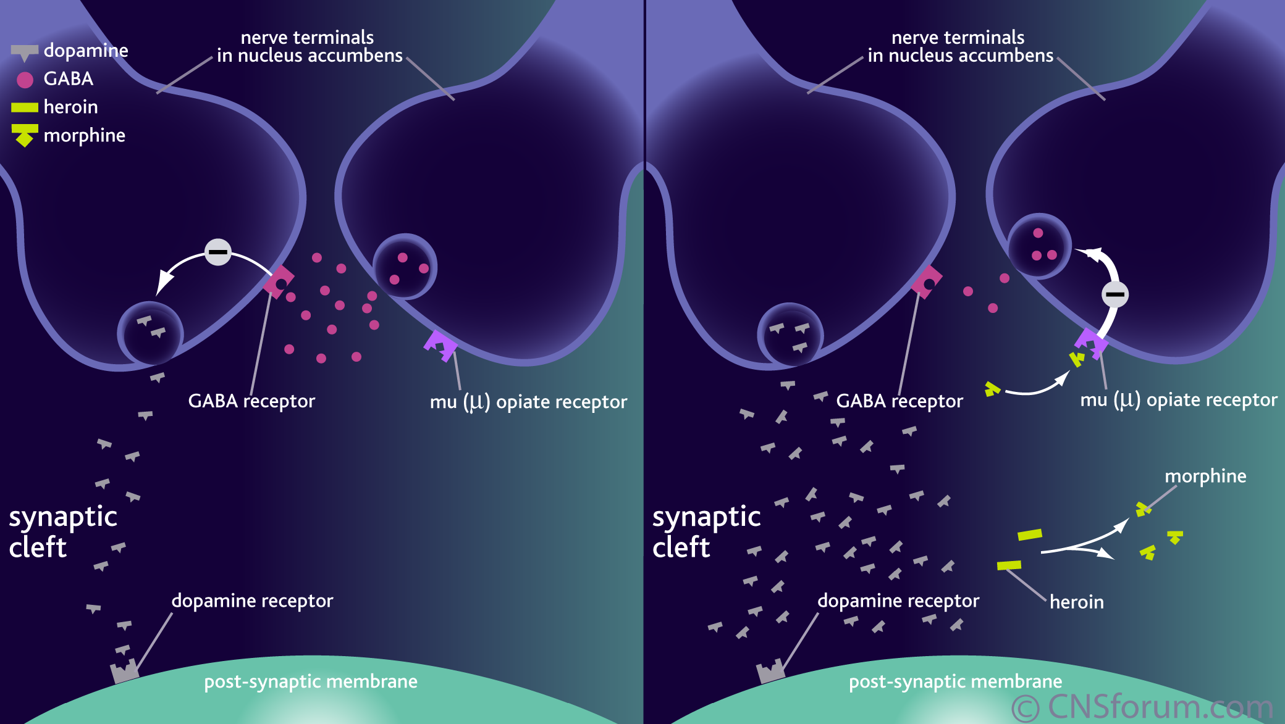
How Heroin Works
Notes:
Heroin modifies the action of dopamine in the nucleus accumbens and the ventral tegmental area of the brain – these areas form part of the brain’s ‘reward pathway’. Once crossing the blood-brain barrier, heroin is converted to morphine, which acts as a powerful agonist at the mu opioid receptors subtype. This binding inhibits the release of GABA from the nerve terminal, reducing the inhibitory effect of GABA on dopaminergic neurones. The increased activation of dopaminergic neurones and the release of dopamine into the synaptic results in sustained activation of the post-synaptic membrane. Continued activation of the dopaminergic reward pathway leads to the feelings of euphoria and the ‘high’ associated with heroin use. Morphine is a weak agonist at the opioid kappa and delta receptor subtypes and activation of these receptors has a weak activating effect on the dopaminergic reward pathway.

Slide 21
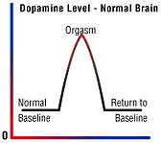
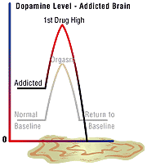
Notes:
Just as we turn down the volume on a radio that is too loud, the brain adjusts to the overwhelming surges in dopamine (and other neurotransmitters) by producing less dopamine or by reducing the number of receptors that can receive and transmit signals. As a result, dopamine's impact on the reward circuit of a drug abuser's brain can become abnormally low, and the ability to experience any pleasure is reduced. This is why the abuser eventually feels flat, lifeless, and depressed, and is unable to enjoy things that previously brought them pleasure. Now, they need to take drugs just to bring their dopamine function back up to normal. And, they must take larger amounts of the drug than they first did to create the dopamine high - an effect known as tolerance.

Slide 22
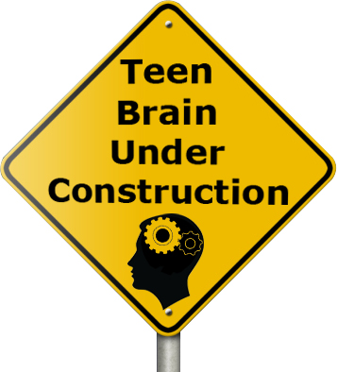
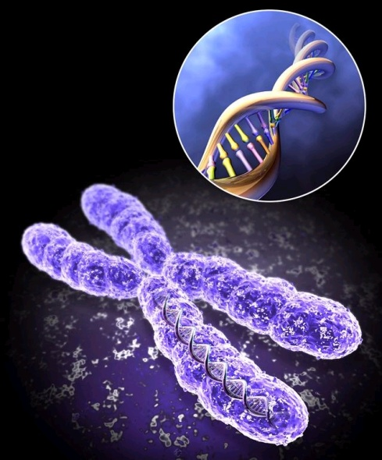


Early Use
Genetics
Trauma

Slide 23
Addiction is a Developmental Pediatric Disease
Source: NIAAA National Epidemiologic Survey on Alcohol and Related Conditions, 2003
Notes:
Adolescents are the healthiest cohort in the population in terms of organic disease but, at the same time, they experience relatively high rates of mortality and morbidity due to their behavior, including the use of alcohol. Across many species including humans, adolescence is a time of heightened risk-taking and for many young people in our society, some of that risk-taking involves alcohol use. Further, adolescence is a period of increasing socialization often involving alcohol. For some, the increased social demands of adolescence may be accompanied by increased anxiety heightening the risk for alcohol use. In this way, alcohol use has become intertwined with the normal developmental processes of adolescence. And alcohol use both affects development and is affected by developmental processes.

Slide 24
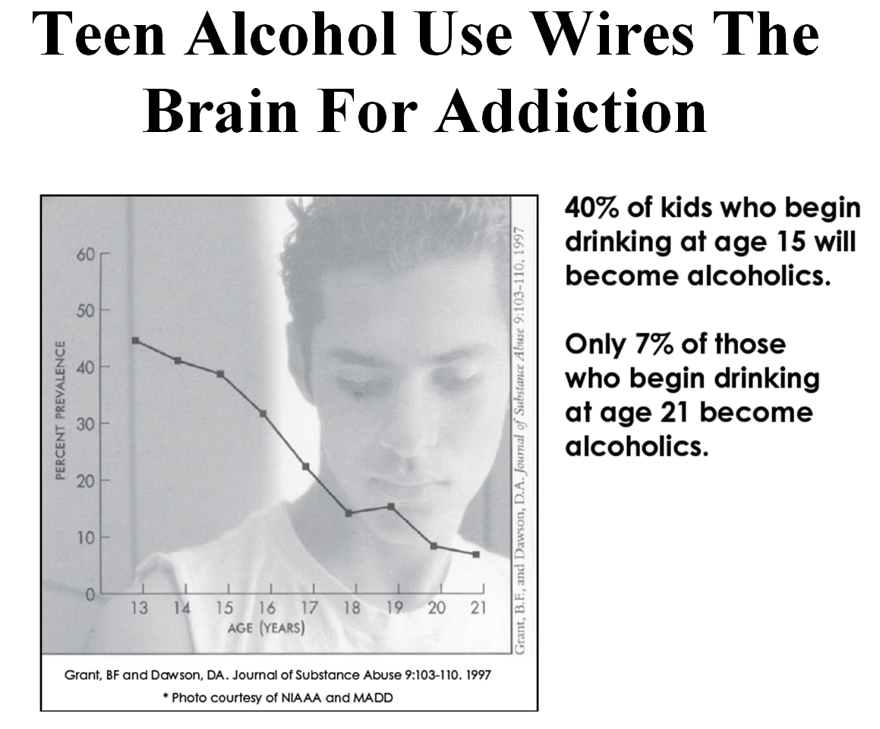

Slide 25
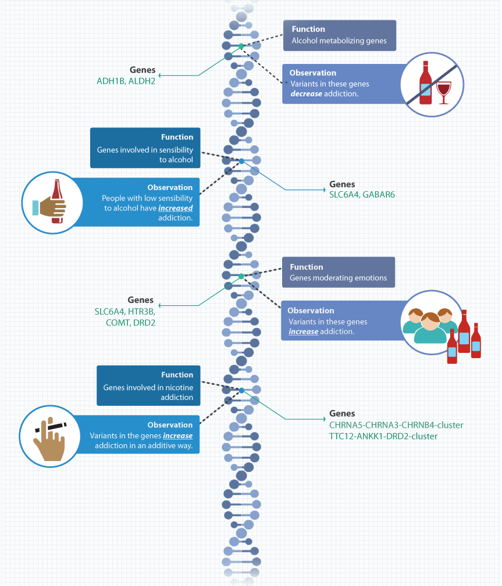
Genetics Account for 50% of
Risk of Addiction

Slide 26

Adverse Childhood Experiences
Emotional Neglect
Abuse
Household Dysfunction
Adverse
childhood
experiences
Household
dysfunction
Emotional
neglect
Abuse

Slide 27
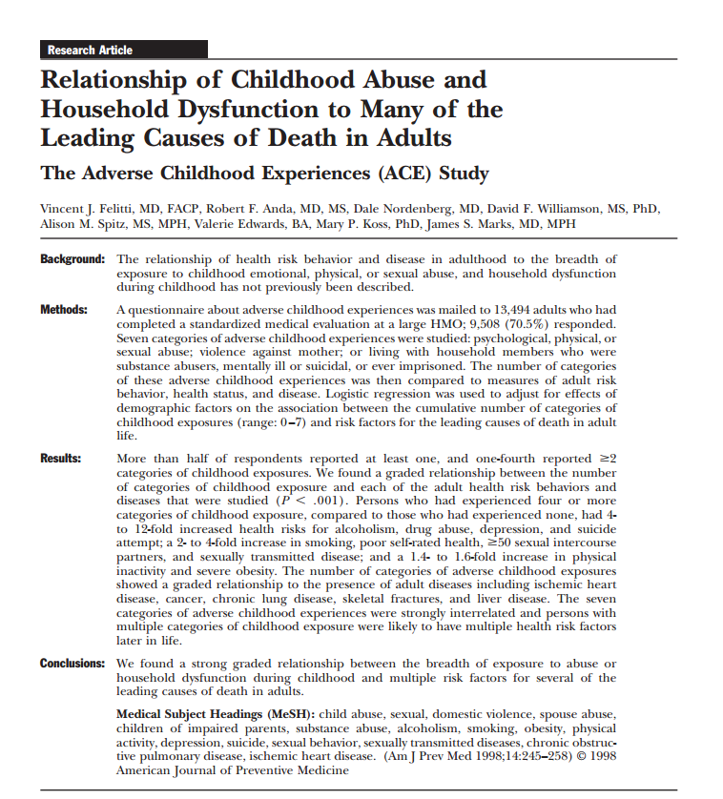

Slide 28
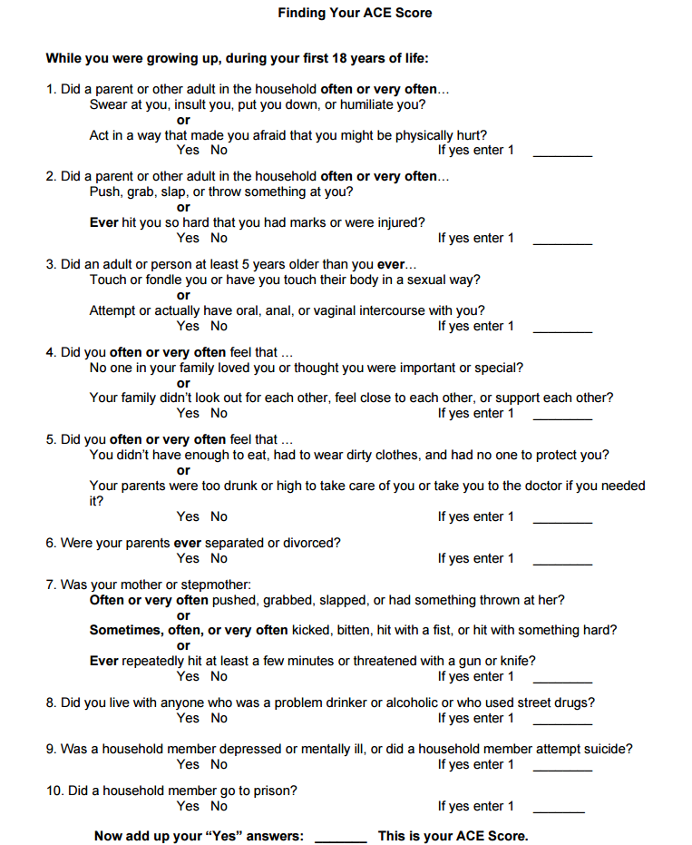

Slide 29
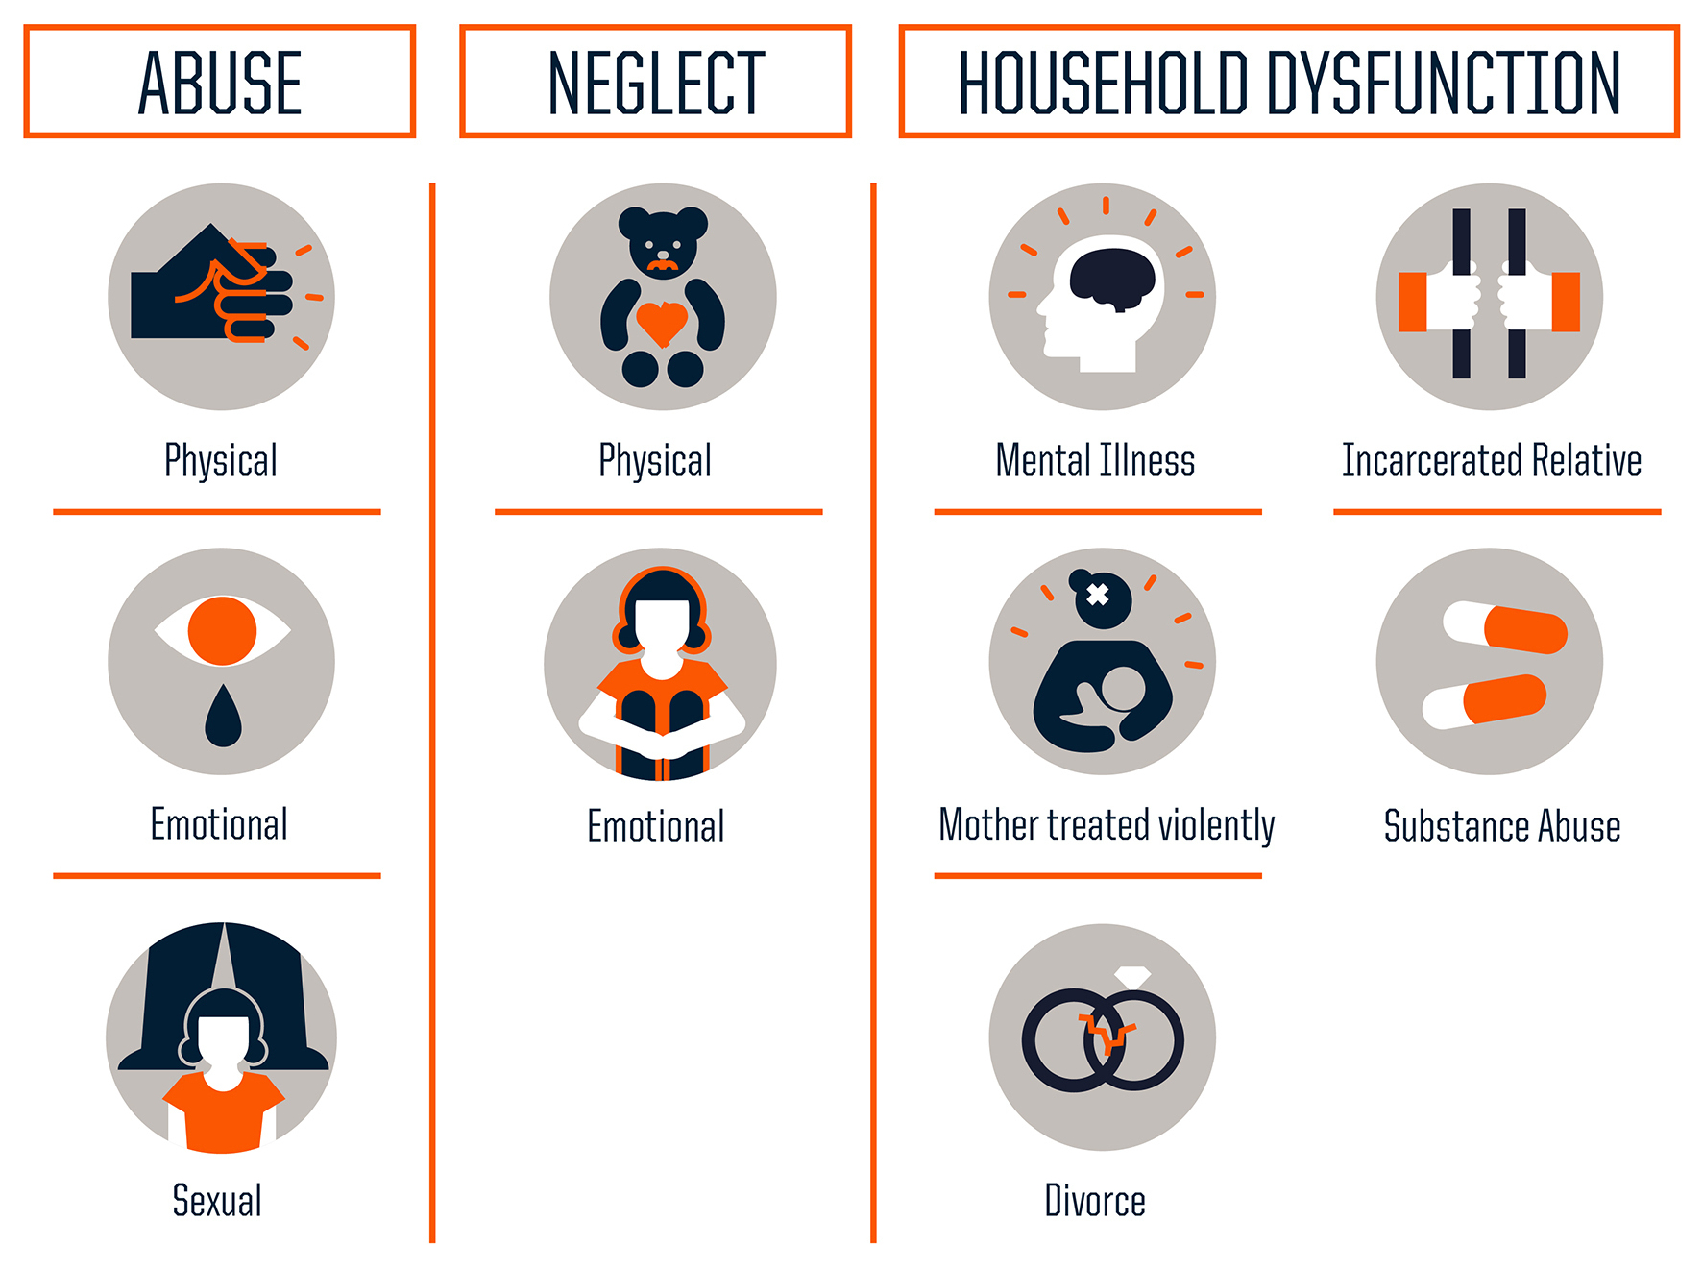
Three Types of ACEs

Slide 30
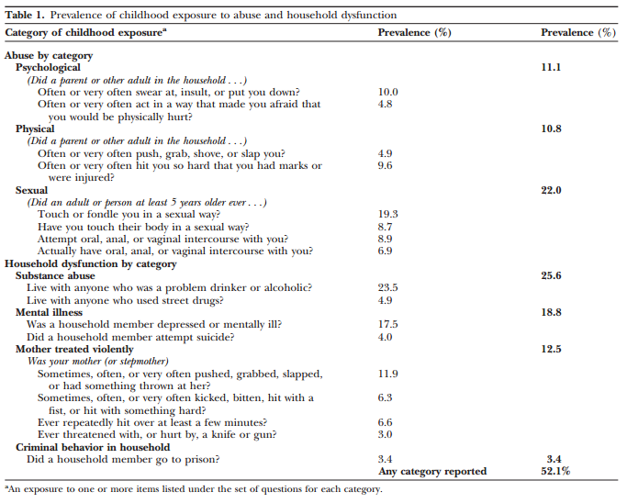

Slide 31
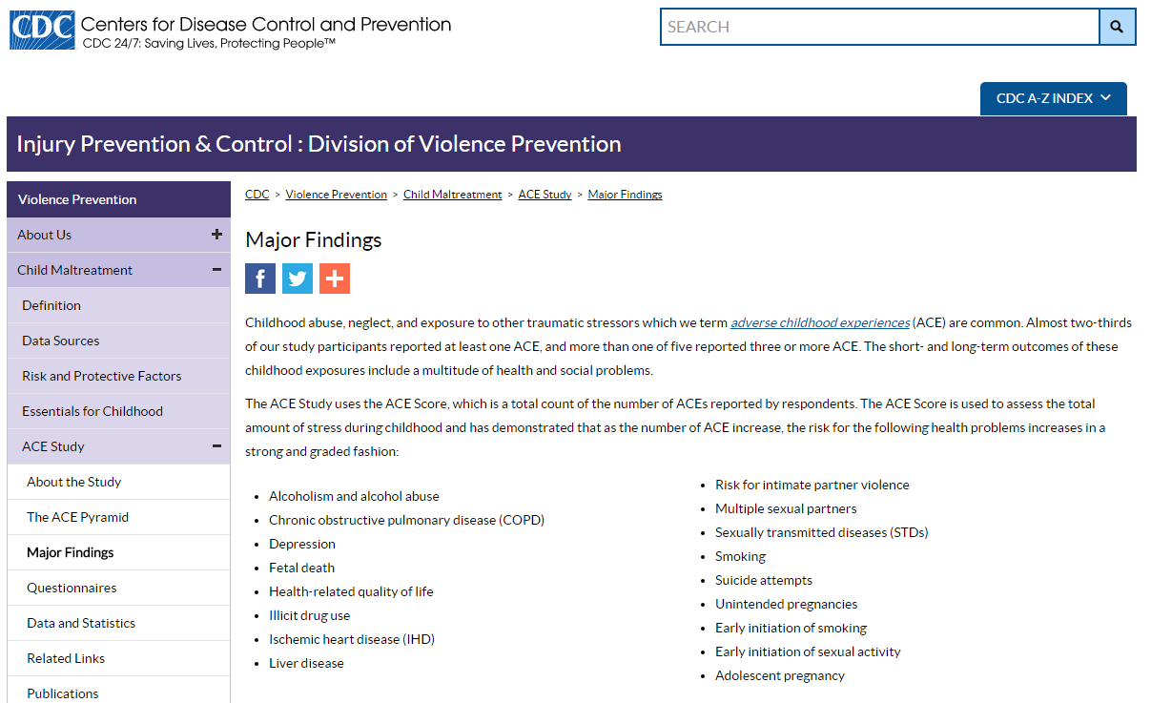

Slide 32
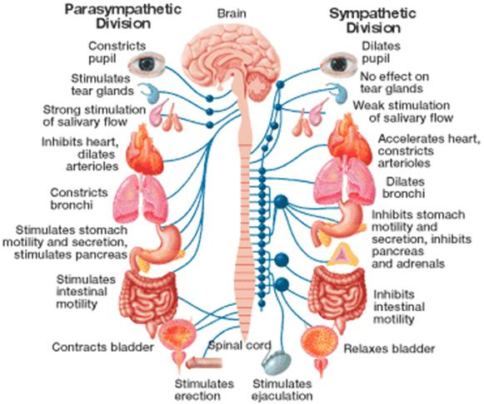
Freeze & Surrender
Fight or Flight

Slide 33
Complex Childhood Trauma
Behaviors
              Aggression
              Disproportionate Reactiveness
              Impulsivity
              Distractibility
              Withdrawal and Avoidance
Three or More Traumatic Events
    Two-and-half times more likely to repeat a grade than are children who
    have experienced none
    Five times more likely to have severe attendance issues
    Six times more likely to experience behavioral problems
    More than twice as likely to be suspended from school

Slide 34
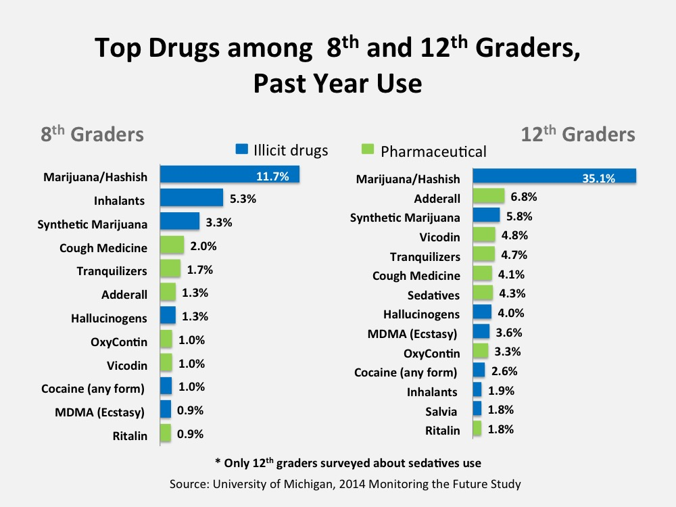

Slide 35
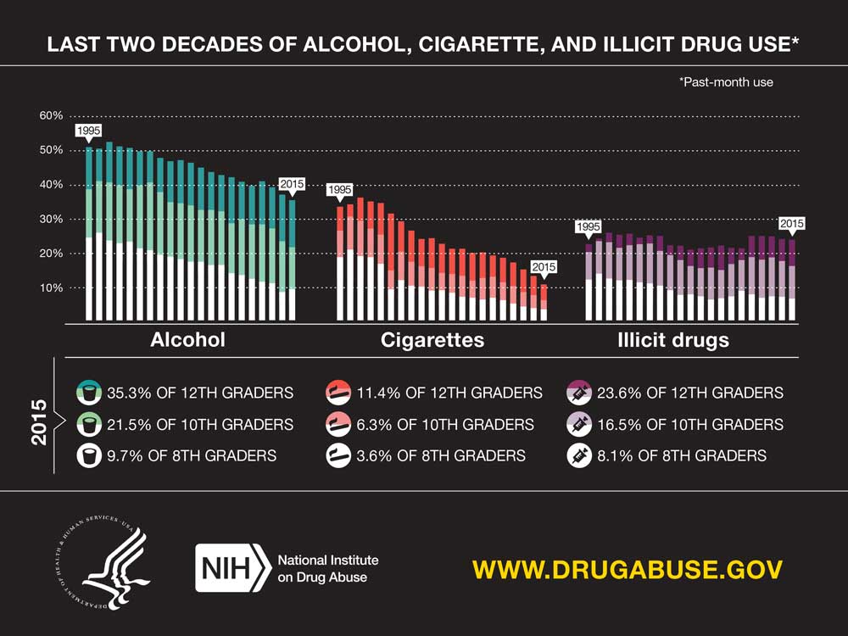

Slide 36
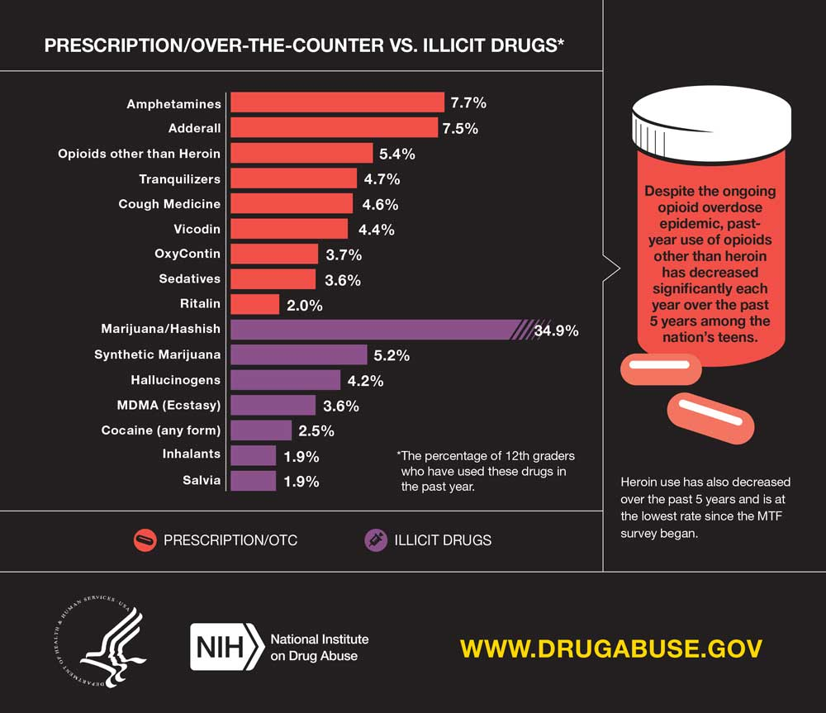

Slide 37
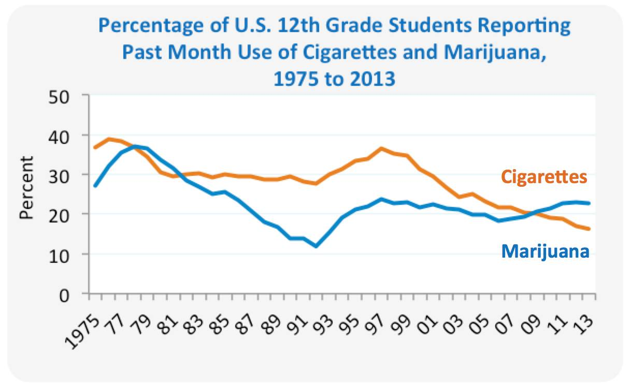
Notes:
In 2013, more high school seniors regularly used marijuana than cigarettes as 22.7% smoked pot in the last month, compared with16.3% who smoked cigarettes. (U.S. Department of Health and Human Services)
Sixty percent of 12th graders do not view regular marijuana use as harmful. (U.S. Department of Health and Human Services)

Slide 38
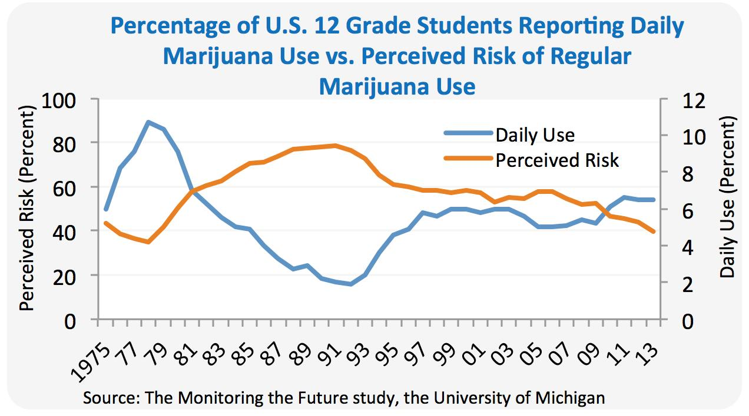

Slide 39
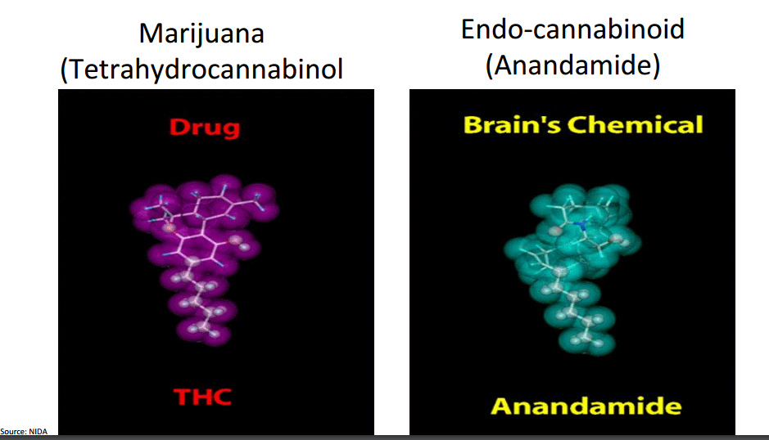

Slide 40
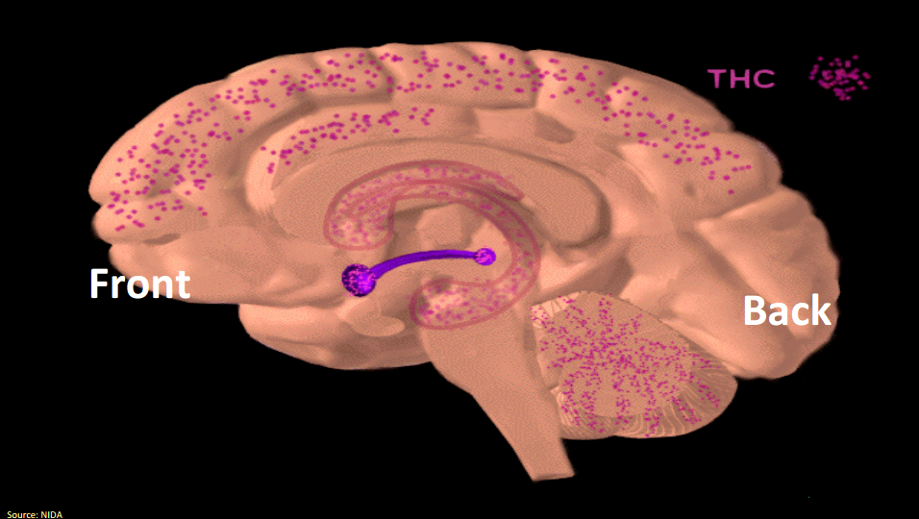

Slide 41
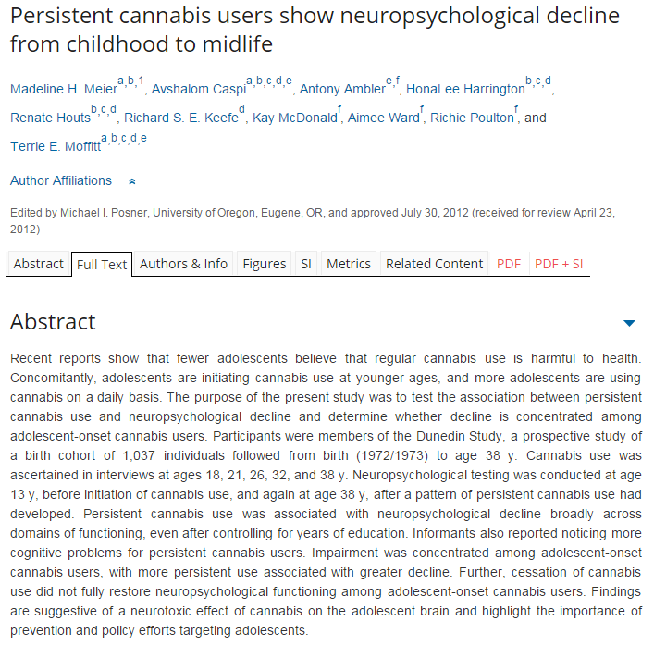
Notes:
When their adult IQ was tested at 38 years old, the heaviest and most persistent adolescent-onset users in the study had experienced an average decline of eight IQ points from childhood to adulthood. Non-users had on average increased their IQ by around one point. And even after setting aside the heaviest users, a decline of a few IQ points from their childhood value was still seen in less heavy users who had started in their teens. What's more, the drop in mental function seemed irreversible even after people had quit cannabis. However, persistent users who only started when adult (older than 18 years) did not seem to experience the same IQ decline.
The effects of the significant increase in the amount of the active ingredient, tetrahydrocannabinol (THC), in the drug over the past few decades also needs to be explored. “You have to remember that when the people in the Dunedin study were kids back in the early eighties, this would have been pretty old-fashioned hash or weed, with THC content of 4–5%," Murray points out. "Today’s skunk has 16–18%, so the effects are most likely to be magnified.”

Slide 42
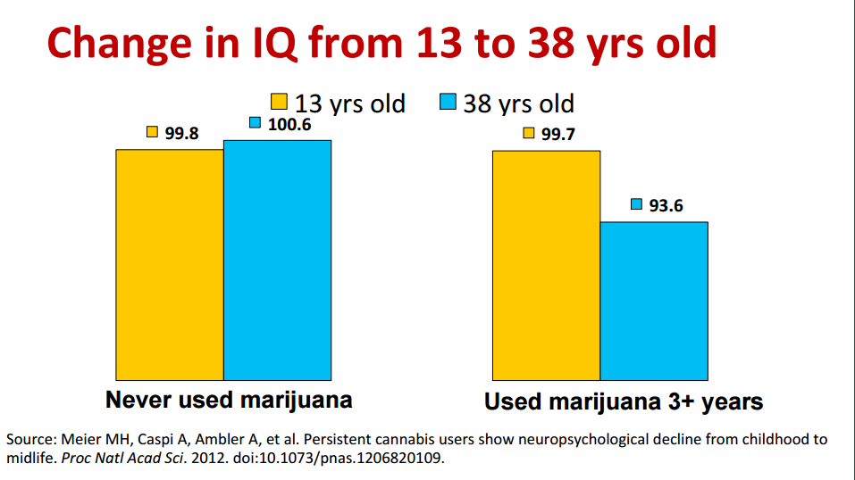

Slide 43
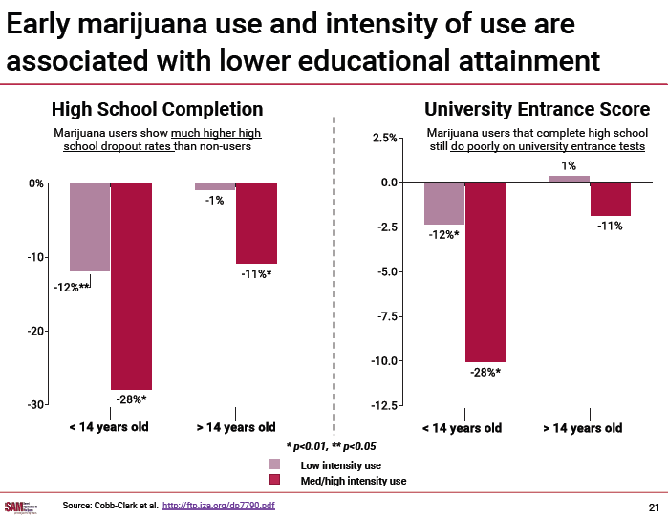

Slide 44
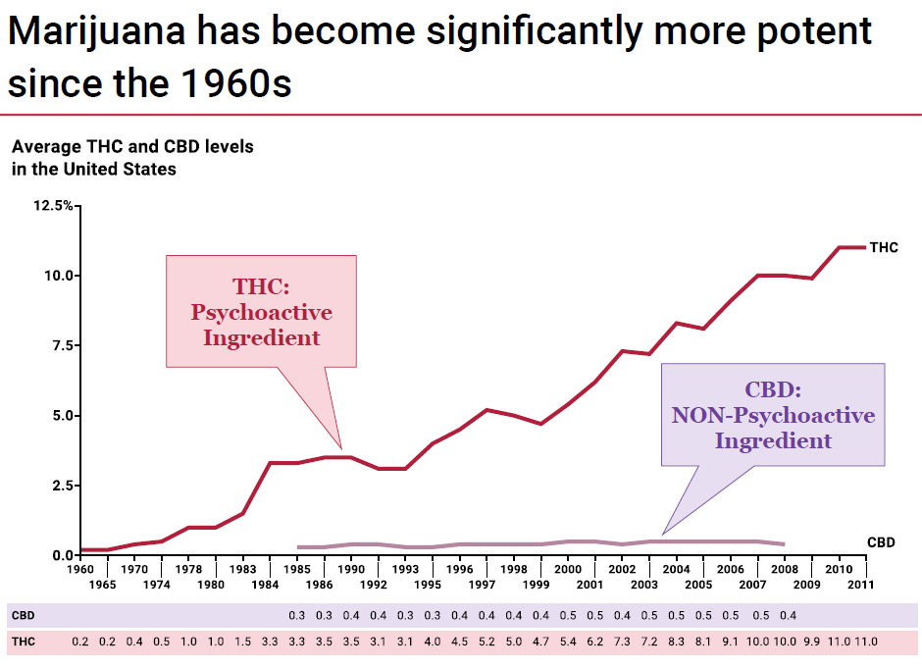

Slide 45
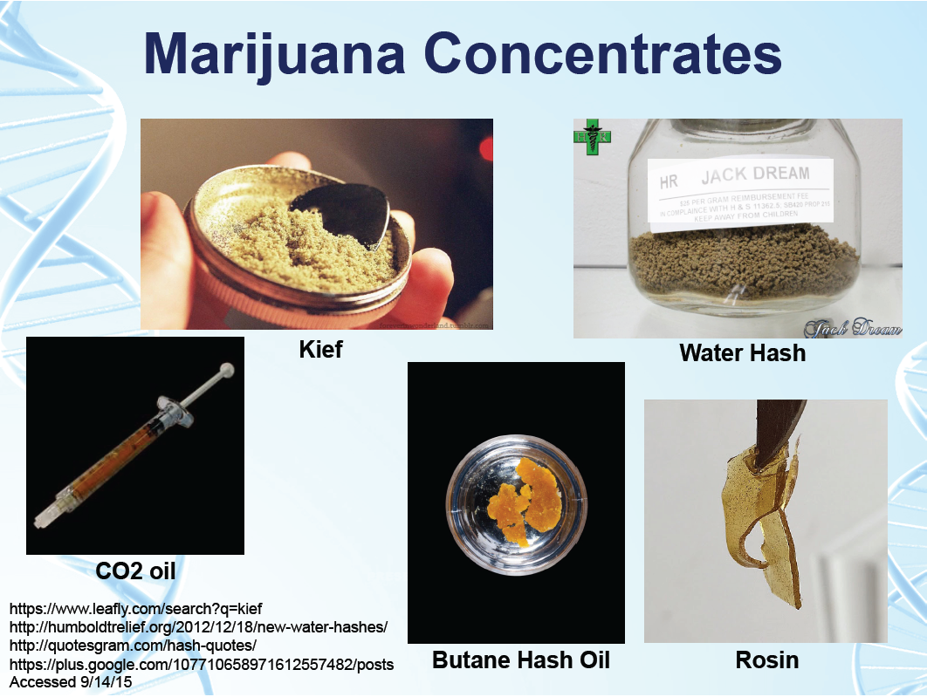

Slide 46
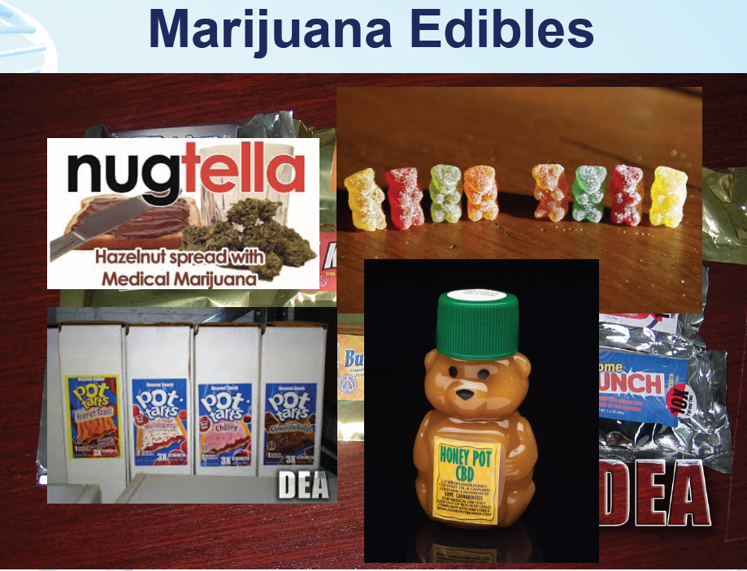

Slide 47
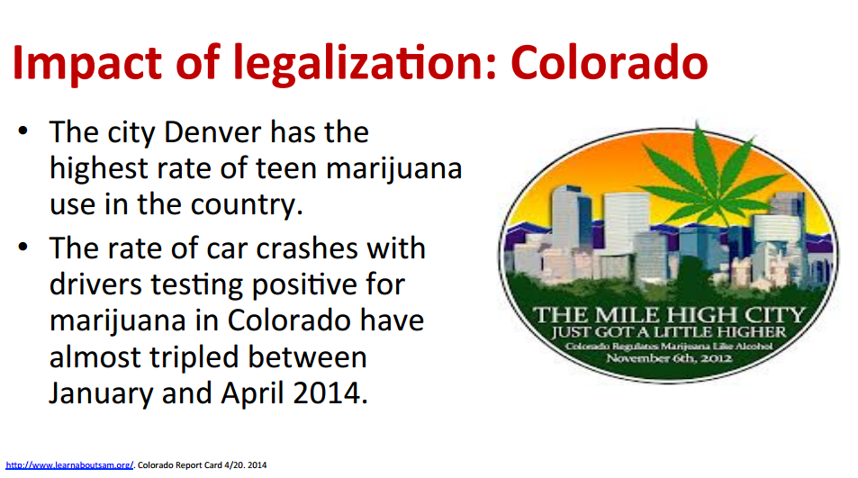

Slide 48
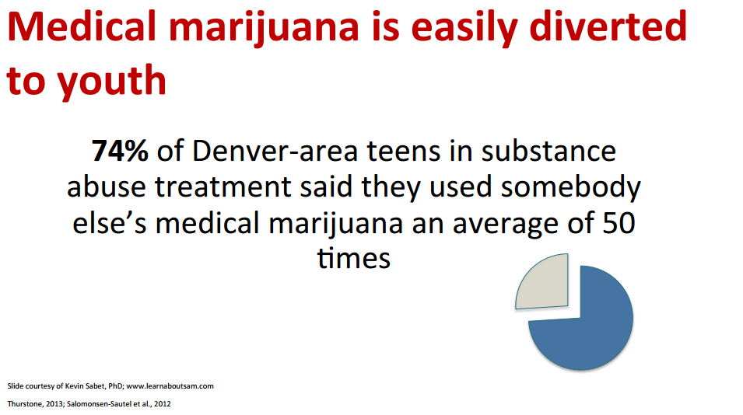

Slide 49
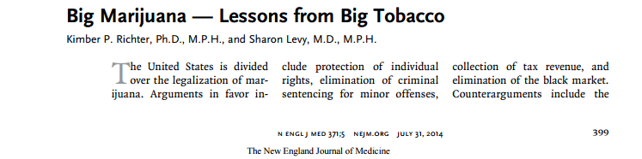
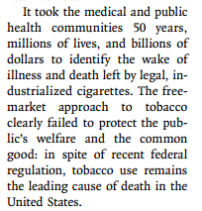
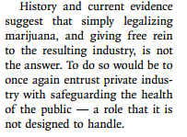

Slide 50

30 Day Prevalence of Daily Use of Cigarettes, by Grade, 1975-2013
Notes:
Good news: smoking is WAY DOWN. Bad news: E cigs are WAY UP!!!!

Slide 51


Slide 52


Notes:
Time Away From the Insulting Agents -

Slide 53


Slide 54

Notes:
Do you remember the maps that used to show obesity in the US?

Slide 55


Notes:
Since 1996 or so, we have been prescribing opiates with a heavy hand. Some of us have been more indescriminate than others. Think about how much you were being told you should prescribe in the 1990s. My father was a primary care doctor in Palmer for 27 years – he can count on one hand the number of times he wrote a prescription for opiates.

Slide 56


Slide 57

http://www.nytimes.com/2011/09/01/us/01drugs.html?src=me&ref=us

Slide 58


Slide 59



Slide 60


Slide 61

Notes:
Massachusetts is not alone in our problems. I think it easy to feel as though Franklin County is the center of the opioid epidemic. It is not. There are many states that are much worse.

Slide 62

Notes:
This is the heroin map now. Imagine Appalachia and the Entire South filled in. Imagine what our rates of Hep C and HIV will be then. Imagine what the death rate will be then. We need to be training people now to recognize and treat addiction in advance of the rug getting pulled out from under people. There is no human benefit in pulling away people’s prescriptions and having them turn to Heroin.

Slide 63






Slide 64
Signs and Symptoms at School
Small or “pinpoint” pupils
An overall unhealthy look
Weight loss
Vomiting
Constipation
“Nodding off” to sleep
Laxative use
In females, not getting a period
Depression
Track marks on arms (scars or bruises from using needles)
Itches and scratches on the skin
Loss of friendships
Problems in school or at work
Lose interest in activities

Slide 65
Signs at Home
More time spent away from home
Frequent, secret phone calls
Trouble with the police
Missing money, credit cards, and/or valuables
Pawn slips
Purchases returned for refunds
Small plastic Ziploc bags
Bottles of vinegar and bleach and cotton balls
Aluminum foil or chewing gum wrappers with burn marks
Spoons with burn marks or missing spoons

Slide 66








Slide 67

Notes:
Get Naloxone Now 59.5

Slide 68







